Slide 1
Course Capstone Project: Location recommendation for an Asian Restaurant in the Charleston Area

Slide 2
Introduction
"Which Charleston Area/Location would it be recommended to open an Asian Restaurant?"¶
For this project, I had the idea to do some analysis in regards to the presence of what Asian Restaurants in Charleston, SC Area.
My wife and I really enjoy Asian cuisine, but we usually have a hard time finding a really good Asian restaurant close to our area. Finding an Asian restaurant gets even more difficult, when we want to narrow down to a specific kind of Asian cuisine, i.e. Korean food.
My object with this report is to provide information in regards the Asian Restaurant presence in the Charleston Area. By the end of this report I will provide enough insight for someone who is researching for a location to open an Asian Restaurant in the area.
Note:
For the scope of this project, I will narrow down to East (Chinese, Japanese, Korean, ...) and Southeast (Thai, Vietnamese, Filipino,...) cuisines.
Kind reminder that Asian cuisine can also be South Asian (Indian, Pakistani, Bangladeshi, ...), West Asian (Arab, Turkish, Mesopotamian, ...) and other regions, but this is not the focuse for this analysis.

Slide 3
Data
In order to identify all Charleston Areas, I will be using the charleston.com web site as a reference of all Areas located in Charleston (https://www.charleston.com/areas). The "Areas", in this case, could represent a city, a town or even a neighborhood.
Once the Areas are identified, I will be using the geopy.geocoders in order to find the main coordinate (latitude and longitude) of each area.
Later, I will use the Foursquare API to extract Food Venues around each Area.
Finally, an analysis will be made with all the food locations with the objective of answering the above question.

Slide 4
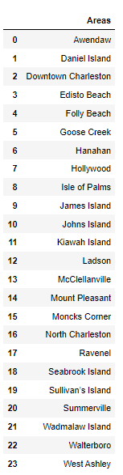
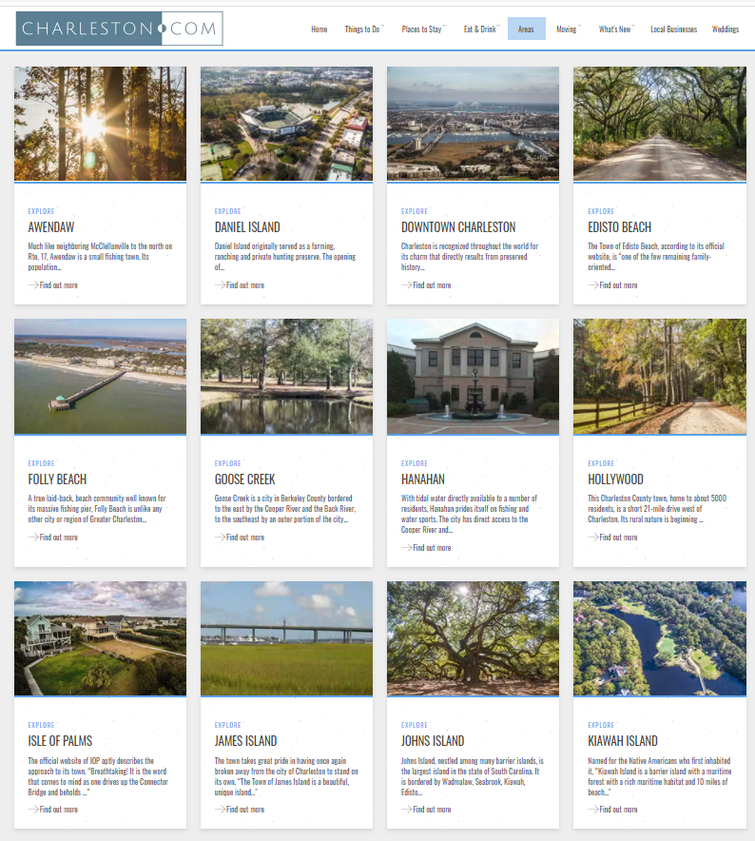
Data - A) Charleston Areas
After analyzing the https://www.charleston.com/areas, we conclude that Charleston has 24 different Areas.

Slide 5
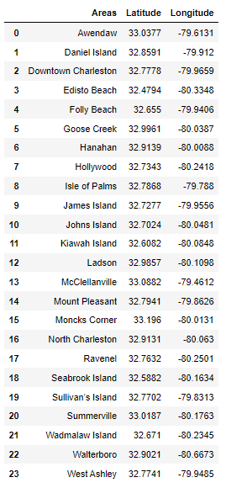
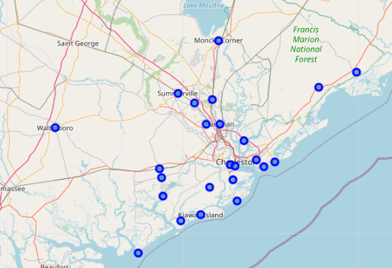
Data - B) Coordinates
We can use the geopy.geocoder in order to identify the coordinates of each location.

Slide 6
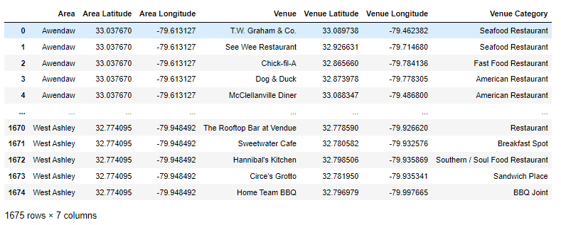
Data – C) Foursquare API
Using the Foursquare API, we are able to identify Food Venues around each coordinate.
The following parameters were applies:
Coordinate of each area;
Section = Food
Radius = 25000 (around 15 miles)

Slide 7
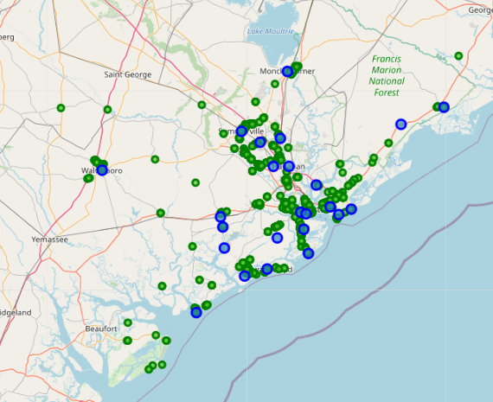
Data – D) Final Data
This conclude all data gathering, which can be presented in the below map.

Slide 8
Methodology and Results
Now that we were able to identify the Food Venue locations in the Charleston Area, the first step that I would like to take is to cluster all the venues and identify the regions with higher density of restaurants.
Depending on the business strategy, a new business owners might want to open a restaurant close to other food locations, which naturally attract a lot of people (reducing on the Marketing cost). On the other hand, some entrepreneurs might prefer locations far away from other restaurants.
In order to create the aforementioned clusters, I will apply the DBSCAN method. With this method, we will be able to create arbitrary shape clusters and the Density-based clustering is also perfect to locate regions with high density vs. low density.
Once these clusters are identified, we can now segment which clusters have a higher or lower Asians cuisine presence. For this step, we will work on identifying what is considered "Asian cuisine" and understand which clusters have more or less Asians restaurants.

Slide 9
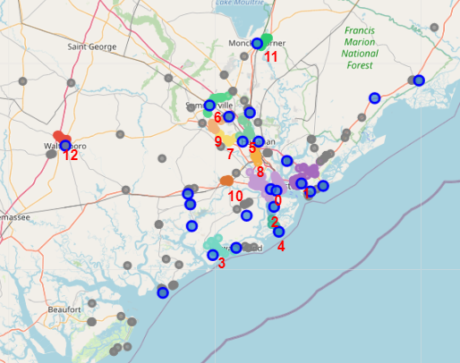
DBSCAN
According to the DBSCAN methodology, we were able to identify 13 different clusters (from "0" to "13").
Note that the outliers are marked in gray.

Slide 10
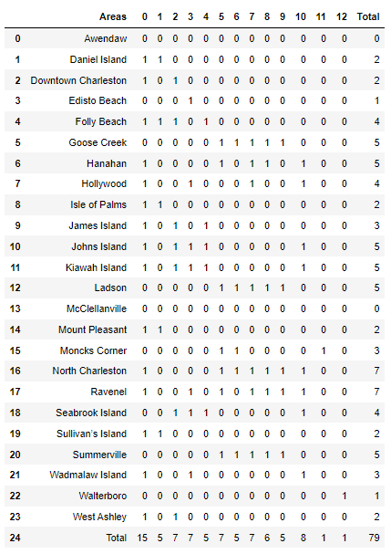
Areas with higher density of venues
3
With some data manipulation we can conclude the following.
Some Charleston Areas do not have any cluster (Awendaw and McClellanville). These are areas that have food venues, but not a significant number that would create a cluster.
On the other hand, we also have the North Charleston area which is close to 7 different Clusters.
Finally, the Cluster Number 0 is the cluster which impacts most areas. This Cluster is mostly composed of restaurants from Downton Charleston. Since this cluster is located "in the center" of Charleston, it is natural to expect that multiple areas will be impacted by this cluster.
1
2

Slide 11
Identifying Asian Restaurants Categories
In total we were able to identify 48 different Categories of Food Venues.
However, we only found the below Asian Cuisines:
Asian Restaurant
ChAsian Restaurant
Chinese Restaurant
Japanese Restaurant
Sushi Restaurant
Thai Restaurant
Vietnamese Restaurant
inese Restaurant
Japanese Restaurant
Sushi Restaurant
Thai Restaurant
Vietnamese Restaurant

Slide 12
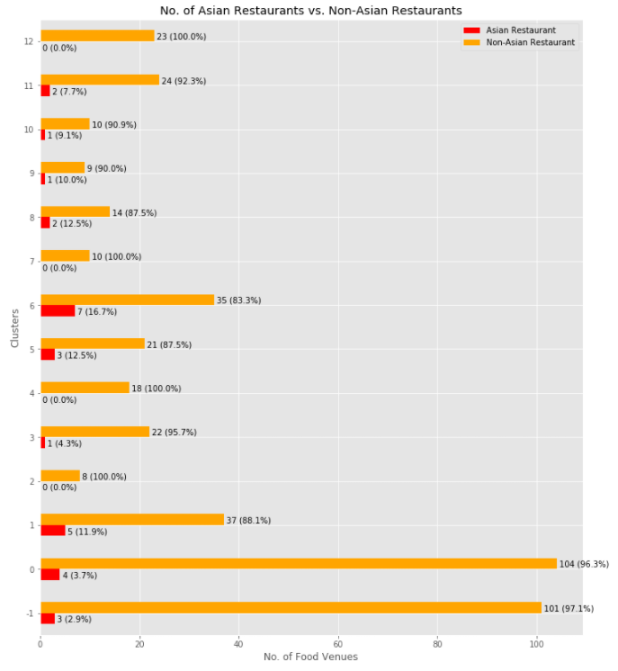
Representation of Asian Restaurants in each Clusters
Overall, only ~6% of the Food Venues identified by the code (using the Foursquare API) might be considered Asian Restaurants;
There are cases that we found Zero Asian Restaurants in a Cluster (No. 2-'James Island', 4-'Folly Beach', 7-'Between North Charleston and Ladson' and 12-'Walterboro')
The only cluster with significant Asian representation (above 10%) are the Clusters 1-'Mount Pleasant', 5-'Between North Charleston and Goose Greek' and 6-'Summerville'.
Finally, the Clusters 1, 5 and 6 not only have a high presence of Asian Restaurants, but it also have a significant number of Food Venues overall (1:108 venues, 5:24 venues and 6:42 venues). The exceptions, would be Clusters 1 and 11, which have 42 and 26 venues, respectively, but not a high present of Asian Restaurants.

Slide 13
Discussion
Based on the above analysis, one could find or prefer the following conclusions for "Which Charleston Area would it be recommended to open an Asian Restaurant?":
A) Distant from all clusters
Some restaurant owners would prefer to open a new restaurant away from all Clusters. On the above analysis, we identified 13 different Clusters which should be avoided in this case. Notice that 104 of 465 Food Venus are not located in a cluster, this more than 22% of all Food Venues. In other words, it is not uncommon for a restaurant in the Charleston area to be isolated or far away from a Cluster.
B) In a cluster with Zero presence in Asian Restaurants
We were able to identify four Clusters without any Asian Cuisine presence.
No. 2 (James Island Area) and No. 4 (Folly Beach Area) are fairly away from Downtown Charleston (avoiding the competition from that area). In addition to that, since these are clusters, a new owner could also take advantage of the cluster, since people/tourists would be already visiting the areas looking for Food Venues.
No. 12 (Walterboro) is another Cluster without any Asian Cuisine, but this area is very isolated to all other Charleston Areas. In this case, it would not take advantage of the tourism from the region. On the other hand, there is a whole population from this City/Area that are not close to any Asian Restaurants.
Finally, No. 7 (Cluster between North Charleston Area and Ladson Area) does not have any Asian Restaurants, but it is surrounded by other Areas with Asian Cuisine. If the objective is to find a cluster with zero presence of Asian Restaurants, this would not be a good choice.

Slide 14
Discussion
C) In a cluster close to multiple areas
Some entrepreneurs have high confidence on their product and, in this case, being located near to most areas would be a great choice. Regardless of the competition, the idea is to be in the middle of everything. For this case, two regions might be interesting:
Cluster No. 0 (Downton Charleston), this is the center/heart of Charleston. It is a highly populated area and it also attract a lot of tourist all year around. This Cluster is surrounded by other clusters and close by different areas such as James Island, West Asheley, North Charleston, Daniel Island and Mount Pleasant.
In the North Charleston Area, this area is surrounded by different Cluster (5, 6, 7, 8 and 9) and very close to other areas such as Hanahan, Goose Greek, Ladson and Summerville. This is an area with a lot of growth and a lot of opportunities.
D) A unexplored "sub-type" of Asian Cuisine
Surprisingly, the code along with the Foursquare API did not identify many different types of Asian Cuisine. This is a sign that there is not much variety of Asian Cuisine in the Charleston Area. On the other hand, perhaps a different API or different parameter could identify more Asians restaurants. Either way, the analysis shown very little representation of Asian Cuisine. This show potential for exploring this kind of cuisine on the Charleston Areas. Some of the types of popular Asian food that were not identified are: Korean cuisine, Singaporean cuisine, Filipino cuisine, …
And although this was not parts of the scope of the project, we were also not able to identify, for example: Indian cuisine, Arab cuisine, Turkish cuisine, …

Slide 15
Conclusion
With this Report/Project one can conclude that there is potential for opening an Asian Restaurant in the Charleston Area.
There are multiple Locations that can be explored or avoided (depending on the business strategy), but overall the Asian Cuisine is not highly present in the Charleston Area (overall only ~6% of the restaurants are Asian). Furthermore, some "sub-types" are little to none present in the area (i.e. Korean Food), which is the biggest advantage that a new restaurant owner could explore.
On a personal note, opening a Korean Restaurant (known to be very popular in other cities/locations) in the North Charleston or Downtown Charleston area is a great opportunity. These two areas are highly populated and centered among most of the Charleston Areas. Moreover, Korean food can stand out among other asian cuisines for presenting a very different type of food (i.e. Korean Barbecue). Furthermore, the Korean Culture has been gaining popularity in the USA.
Naturally, this is only one aspect of analysis that an investor would take in consideration. A lot of indicator were not approached such as: population/demographic target, infrastructure cost, staffing requirements, marketing/advertisement requirements, ... However, this is not the scope of this project. The only aspect that we are targeting is location.

